Slide 1
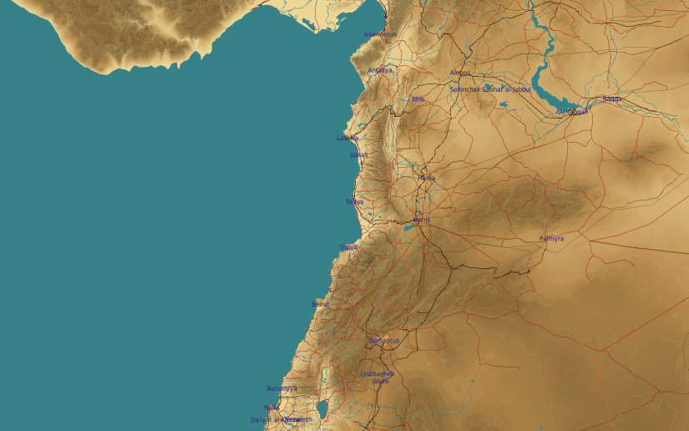
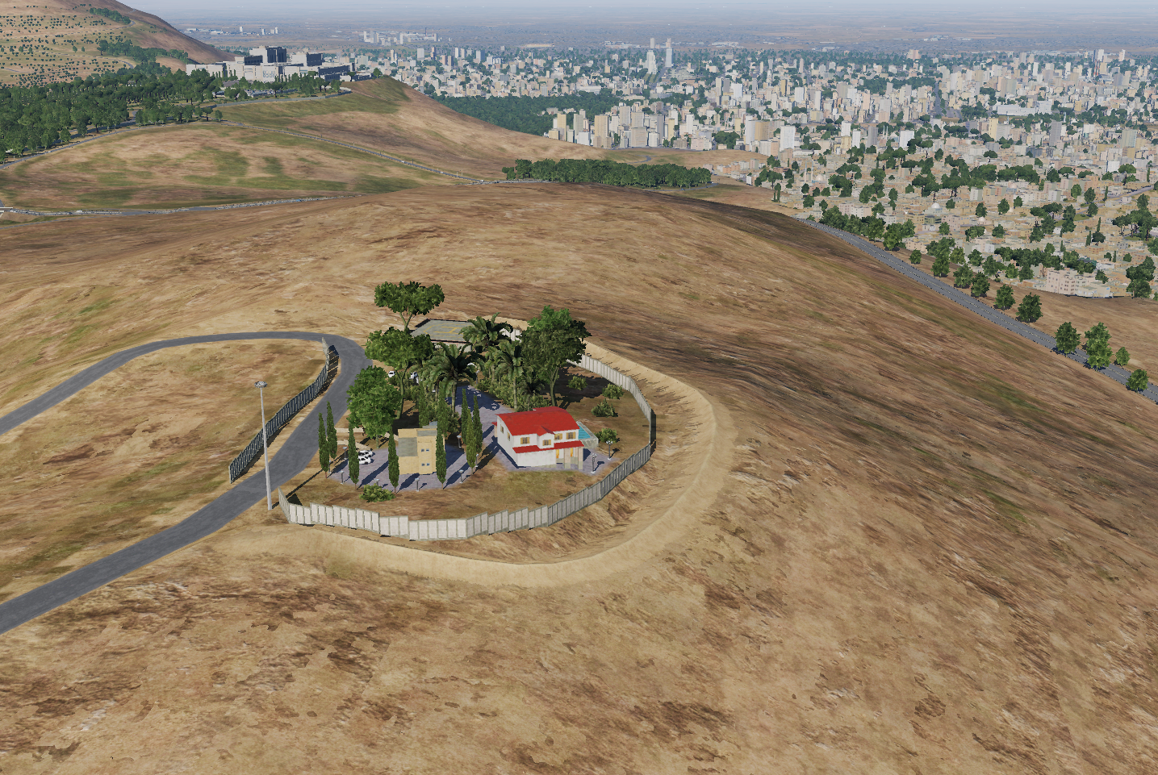
SYTGT086 Syrian Armed Forces Commander Residence
N
86
1
DESCRIPTION OF THE DESIRED POINTS OF IMPACT WITH WPN TYPE:
SYTGT086 – Commanders Residence
DPI 1 N33 30.546 E036 13.651/3202ft/(1000 Ibs bomb)
4
5
6
Civilian residential areas SE and W of the DPI1 within 650m.
7
8

